Slide 1



May 2025 Buy Trip

Slide 2
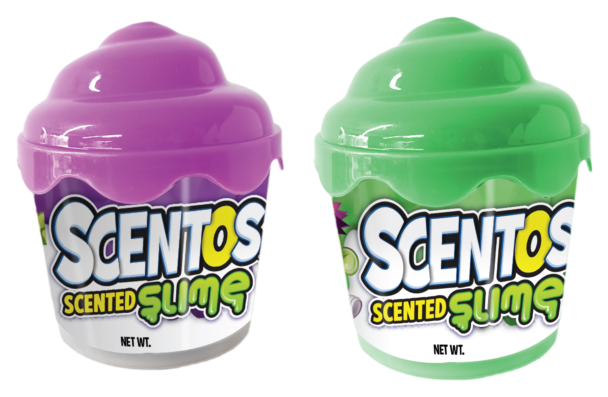
40996
SCENTOS SLIME, WHIPPED TUB
Dims: W 7.1 cm x D 7.1 cm x H 8.9 cm
FOB : $0.67
Suggested Retail AU: $3

Slide 3

THANK YOU

